Slide 1
Writing Effective Alternative Text
Robin Cole
Alternate Format Manager
Office of Accessible Education
Stanford University
rlcole@Stanford.edu

Slide 2
Alternate Format Production
Office of Accessible Education
Stanford University
Ensure students have access to educational materials in a format that is accessible to them.
- doc
- accessible (tagged) pdfs
- tactile graphics
- html, including mathml
- braille
Appropriate format provided depends on the student and subject.
Notes:
-remediate materials that professors are using in their classes so it’s accessible to a specific student.
-not content creators
-review formats

Slide 3
Notes:
-people who turn off images to reduce their data consumption
-needed for anyone who can’t access information visually

Slide 4
How to Start
Summarize what you see in one sentence
Keep it neutral and informative
Use proper grammar, punctuation and spelling
Avoid acronyms and symbols
If the image includes text, include that text in the Alt Text
When to Stop
Best practice is 125 characters, or the length of a tweet
JAWS screenreading software default setting pauses after 250 characters
Alt Text can be longer if necessary, depending on its purpose or audience

Slide 5
Context is Critical
No Context
ALT text = A mostly empty stadium.
On a page about recent turnout for track tryouts.
ALT text = Harvard Stadium with two lone runners bounding up the steps.
On a page about renovation projects at Harvard
ALT text = Harvard Stadium with cracked concrete pillars.

Slide 6
Why was the image included?
Is the image decorative only?
    No description is required for decorative images
Read the surrounding text to ascertain the information the image is conveying
Consider this painting of George Washington at Valley Forge
Is the point of this image in the document to show winter in Valley Forge or that Lafayette and Washington were at Valley Forge?
The answer will affect the Alt Text that you write.
ALT = Valley Forge in winter. The landscape is snow covered and soldiers are sitting by the open road with a camp fire. (emphasizing winter in Valley Forge.
ALT = Washington and Lafayette on horseback talking to soldiers in snow at Valley Forge. (emphasizing Washington and Lafayette)

Slide 7
Consider your Audience
Know your target reader
  Age
  Education level & subject matter expertise
  Use vocabulary and phrases appropriate for your target reader
    Descriptions for lay people should be simpler than those for subject matter experts
ALT = This is a photograph of the Louvre Museum in France at night. The entrance to the museum is a large pyramid made of glass.
This image in context:
This photograph of the Louvre is part of an introduction to a chapter in a history textbook for young children.
The description uses language and introduces shapes appropriate for a young child.

Slide 8
Be Concise
More is not better – be succinct
  Don’t repeat information in the surrounding text
  Include color ONLY if it is significant
Are the colors of the orbital paths significant?
A quick read of the surrounding text has determined they are not, nor have the names of the planets been mentioned.
ALT = The orbiting paths of the eight planets in our solar system around the sun - Mercury, Venus, Earth, Mars, Jupiter, Saturn, Uranus and Neptune.
This image in context:
This photograph and caption are from a fifth grade science textbook in a section about our solar system.

Slide 9
Be Objective
Describe ONLY what you see
    Physical appearances rather than possible intentions
  Don’t interpret or analyze the material
    Allow readers to form their own opinions
ALT = A puffin bird with white liquid projecting from its tail end stands on a rocky mound covered by white excrement.
Instead of
ALT = A puffin standing on a filthy rock while defecating.
This image in context:
This photograph is found on a geology website discussing various events that lead to the acid erosion of rock formations over time.
This description quickly identifies the puffin as a bird for those who may not be familiar.

Slide 10
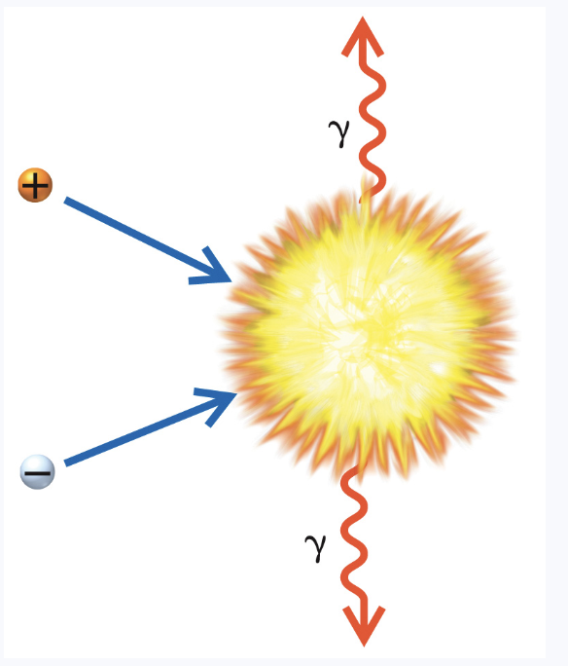
Focus on Meaning
Avoid the common mistake of describing the appearance of symbols.
Instead focus on the meaning, as that’s the most important information to relay.
Avoid saying “ball labeled with a plus sign” - call is “a positron”.
Use “gamma ray” rather than “a squiggly arrow labeled with a funky y”.

Slide 11
Go from the General to the Specific
  Start with high-level content then drill down to details
ALT = A map of the United States made out of recycled license plates. This “recycled map” is about five feet wide, with each state represented by license plate cutouts from the respective state. Large states such as Texas and California are made of one or more colorful metal license plates while smaller New England states are represented by just a few inches of their license plates.
This image in context:
This map is found in an art history book in a section that introduces the concept of using recycled materials to produce art.
The description starts with high-level context about the “recycled map,” and then provides readers with the option to drill-down and learn more about the collage.

Slide 12
Tone and Language
  Use active verbs in the present tense
  Check spelling, grammar and punctuation
  Write out abbreviations and symbols
  Use descriptive language that adds meaning
    “map” instead of “image”
    “photo” instead of “image”
ALT = A photograph of a blue sky peeking through grey storm clouds over the Grand Canyon in early September.
This image in context:
This photograph of the Grand Canyon was taken in early September, which is Arizona’s monsoon season. It appears in a book about national parks in the United States.
The photograph accurately captures the tone of the scene. After hearing about the “violent” storm in the text that precedes the image, the use of “peeking” to describe the blue sky creates the right tone.
The description avoids the use of abbreviations such as “Sept.” to ensure proper reading by screen readers.
While the description is an incomplete sentence, it is clear and brief, which ultimately benefits the reader.

Slide 13
Some Specialized Content
Graphs
Determine if the graph can be summarized in a sentence or two.
If not provide the data in a table with row and column headings.
Venn Diagrams
Focus on the data, not the appearance.
Give a summary if one is apparent.
Flow Charts
Simple flow charts can become nested lists or outlines

Slide 14
Let’s try writing some Alt Text

Slide 16
Notes:
Photo of a man in a suit standing on a tight rope high above a city skyline.

Slide 17
Writing Effective Alternative Text Takeaways
Context is Key
Know the Target Audience
Be Concise
Be Objective
Focus on the Meaning
Go From the General to the Specific
Match the Alt Text Tone and Language to the text
Seek out Subject Matter Experts

Slide 18
Additional Resources
  DIAGRAM CENTER
    http://diagramcenter.org/general-guidelines-final-draft.html#2
    My examples are primarily from DIAGRAM CENTER
  WebAIM
    https://webaim.org/techniques/alttext/

