Slide 1
Let Them Claim Their Own Corner of the Web! with Stanford Domains
Caitlyn craft
ccraft@stanford.edu

Slide 2
Agenda
Build It (Well): And they will come
Teach It: By training the trainers
Support It: With a documentation-driven approach
Demo It: Live Stanford Domains demo!

Slide 3
Build It (Well)
Notes:
If this is done right, it’s as simple as giving access and letting folks know it’s there
Almost a set it (and forget it) implementation for administrators

Slide 4
Stanford Domains
Stanford Domains offers the opportunity to register a free subdomain (mysubdomain.su.domains) and create a digital presence through various mediums such as WordPress.
This includes full cPanel access to over 100 open source applications, unlimited subdomains, FTP, email, databases, and more.
All free!
Notes:
It’s completely equivalent of what you’d get with a GoDaddy web hosting account except you’re charged for every add-on

Slide 5
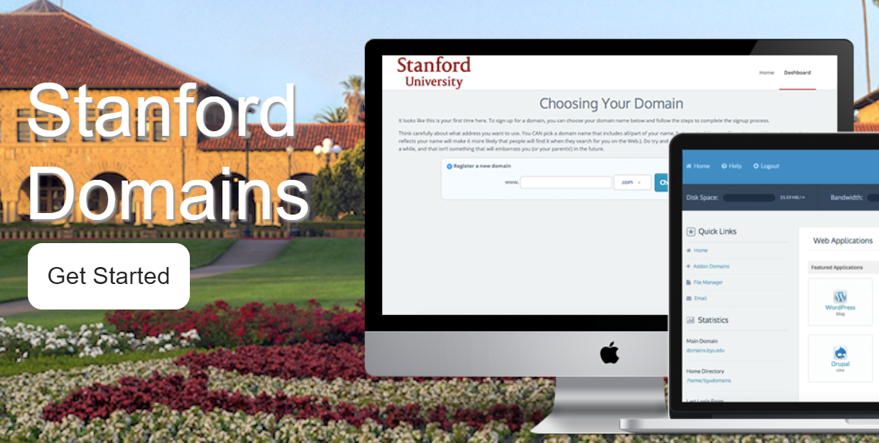
Under the Hood
Stanford Domains is supported
by Stanford VPTL and powered
by Reclaim Hosting.
Notes:
Reclaim Hosting provides educators and institutions with an easy way to offer their students domains and web hosting that they own and control.
Their goal is to make the process of offering a flexible web space and domain name to your students as easy as possible and giving you the support you need to make it all happen.

Slide 6
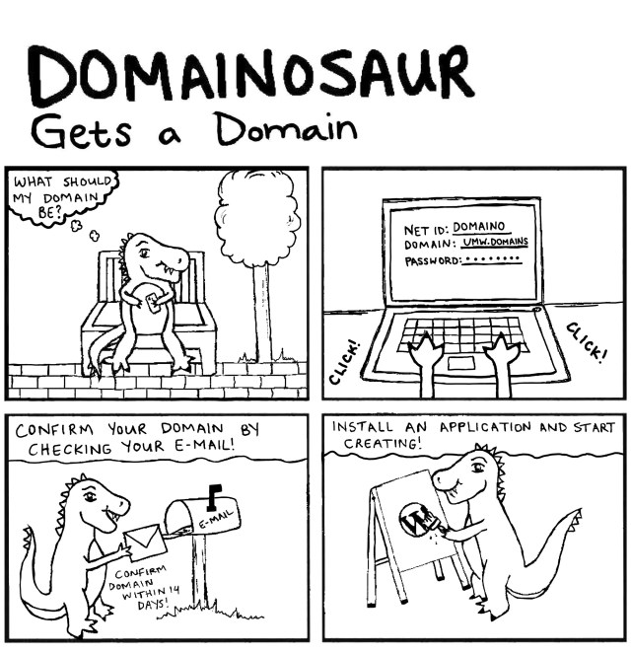
Under the Hood
University of Mary Washington was a pioneer in this space piloting their Domain of One’s Own project in 2012-2013 as Reclaim Hosting formalized their hosting platform.
Bethany Thomas @ https://umw.domains
Notes:
UMW realized the pedagogical impact of equipping faculty, staff, and students with tools to let them claim their own corner of the web

Slide 7
Teach It
Notes:
How you can support your folks by taking a centralized approach to decentralized spaces
I teach primarily graduate students how to build a web presence for their professional portfolio or group projects

Slide 8
Web Host
Company that provides space on a server owned or leased for use by clients, typically in a data center.
This is where you live online. Your landlord. Most everyone rents.
http://icons.iconarchive.com/icons/paomedia/small-n-flat/1024/house-icon.png

Slide 9
Domain
Subdivision of the Internet consisting of computers or sites usually with a common purpose.
This is you giving everyone directions to where you live online.
www.palmdrive.com
http://icons.iconarchive.com/icons/paomedia/small-n-flat/1024/house-icon.png

Slide 10
cPanel (Control Panel)
Online Linux-based web hosting control panel that provides a graphical interface and automation tools designed to simplify the process of hosting a web site.
The landlord just gave you permission to change whatever you want.
http://icons.iconarchive.com/icons/paomedia/small-n-flat/1024/house-icon.png

Slide 11
Subdomain
In the Domain Name System (DNS) hierarchy, a subdomain is a domain that is a part of a main domain.

Slide 12
Web Virtual Host (Vanity URLs)
Looking to acquire https://mygroupname.stanford.edu? This is possible if you are a Stanford recognized student group.
How to request a Stanford vanity URL:
https://uit.stanford.edu/service/vhost
Learn more about Stanford recognized student groups:
https://sal.stanford.edu/get-involved/start-new-student-organization

Slide 13
Content Management System (CMS)
A computer application that supports the creation and modification of digital content.

Slide 14
WordPress
WordPress is a free and open-source content management system (CMS) based on PHP and MySQL.
https://s.w.org/style/images/about/WordPress-logotype-alternative.png

Slide 15
Plugin
WordPress' plugin architecture allows users to extend the features and functionality of a website or blog.
https://wordpress.org/plugins/

Slide 16
Theme
Themes allow users to change the look and functionality of a WordPress website without altering the core code or site content.
https://wordpress.org/themes/

Slide 17
Approach
Know your audience
Know your purpose
Think content first, design later
Create a content map to connect your group’s goals with relevant content outputs.

Slide 18
Goals -> Content -> WordPress
Educate others
Blog
Posters
Foster community
Events
Tweets
Case studies
Podcasts
Forum
Build awareness
About us
FAQs
WP Plugin: The Events Calendar
WP Plugin: bbPress
WP Page
WP Plugin: Ultimate FAQ
WP Plugin: Seriously Simple Podcasting
WP Posts
WP Posts
WP Posts
WP Plugin: Jetpack

Slide 19
Communication Channel Alternatives
Social Media:
Twitter
Facebook
LinkedIn
Mailing Lists:
https://uit.stanford.edu/service/mailinglists (Stanford recognized student groups)
Google Groups

Slide 20
Support It
Notes:
Documentation-driven approach allowing VPTL to set it and forget it
Canvas
Reclaim documentation
LinkedIn Learning

Slide 21
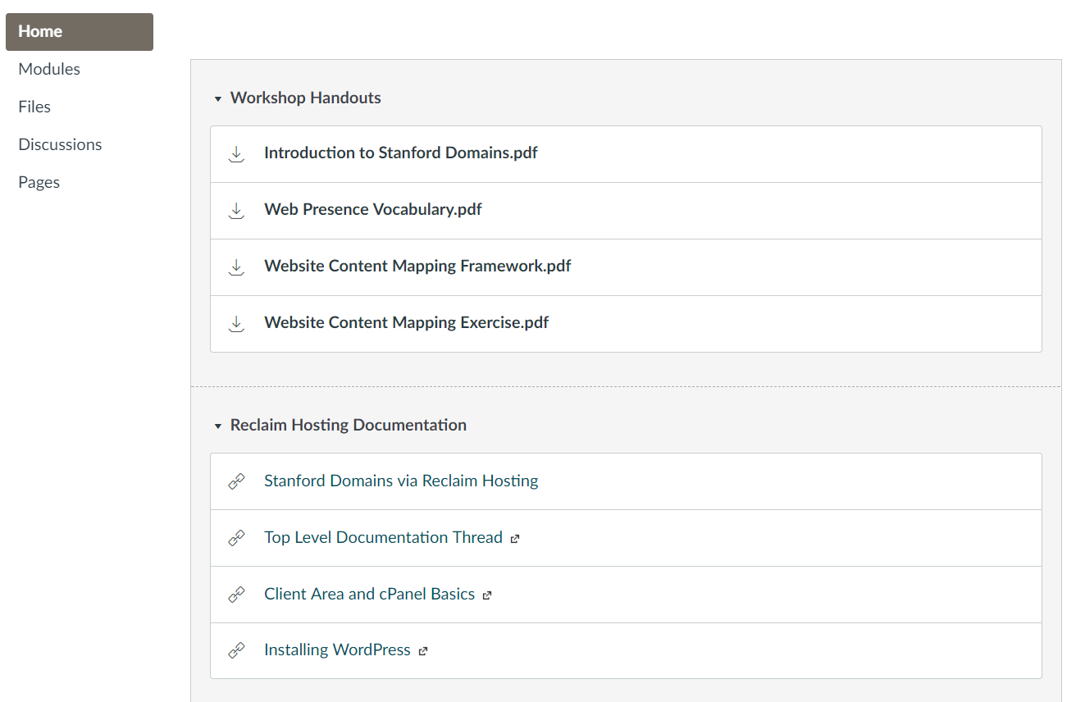
Resources Available in Canvas

Slide 22
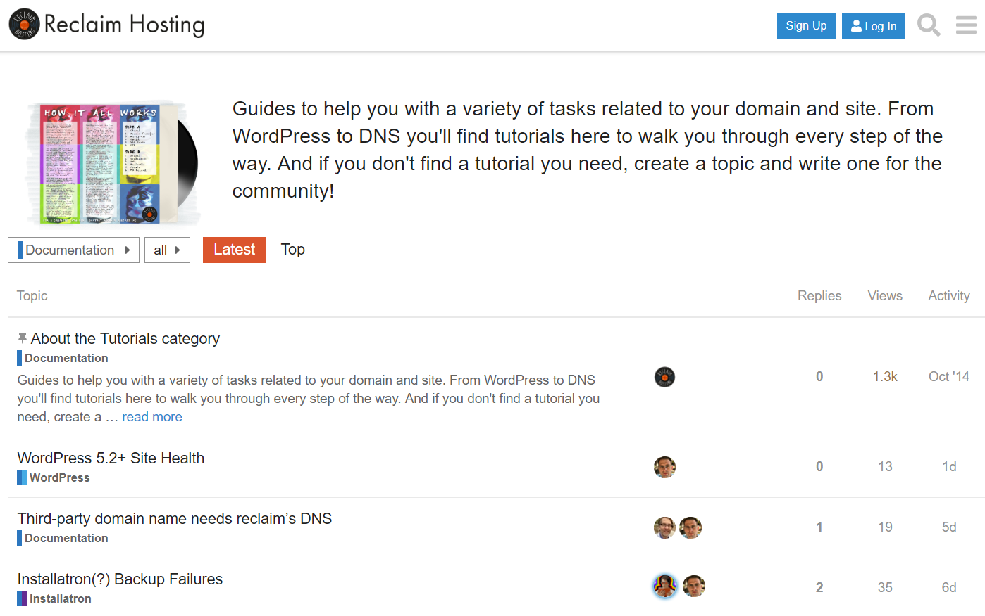
Reclaim Hosting Documentation

Slide 23
LinkedIn Learning Videos

Slide 24
Demo It

Slide 25
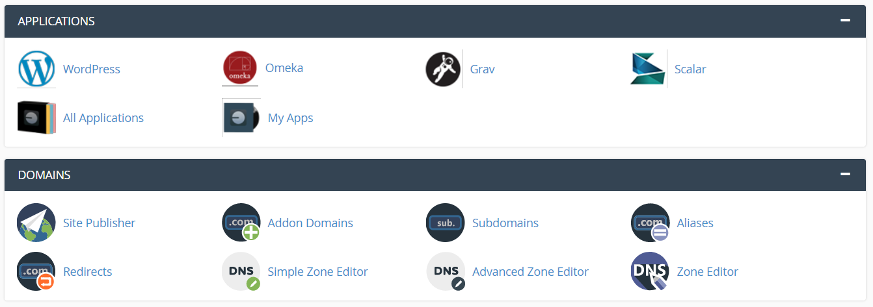
Stanford Domains cPanel Demo

Slide 26
Next Steps
Request Stanford Domains account https://domains.stanford.edu
Want to join the Stanford Domains Canvas course or receive these workshop materials? Leave me your email.

